Slide 1
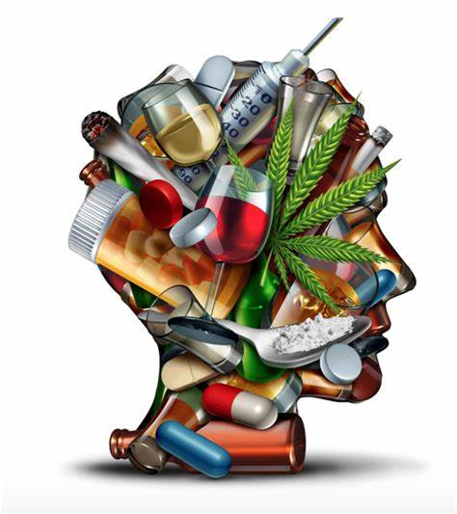
DRUG INTERACTION
BY
DR.G.AARTHIPRIYANKA
POST GRADUATE
DEPARTMENT OF PHARMACOLOGY

Slide 2
DEFINITION

Slide 3
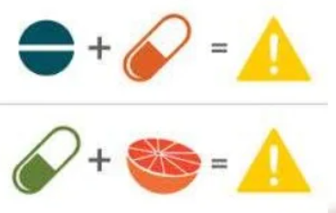
Drug interaction is defined as the pharmacological activity of one drug is altered by the concomitant use of another drug or by the presence of some other substance
Notes:
When a drug is administered, a response occurs. If a second drug is given and the response to the first drug is altered, a drug interaction said to have occurred.

Slide 4
TYPES OF DRUG INTERACTIONS

Slide 5
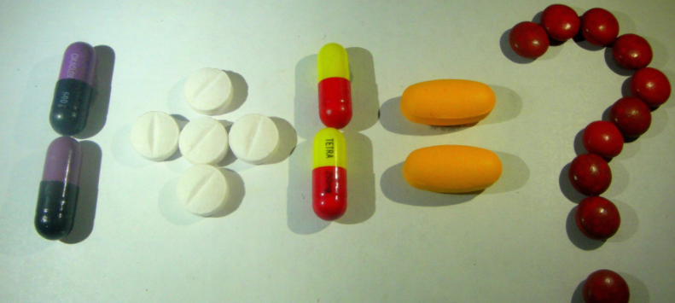
TYPES OF DRUG INTERACTIONS
1.Drug-drug interactions

Slide 6
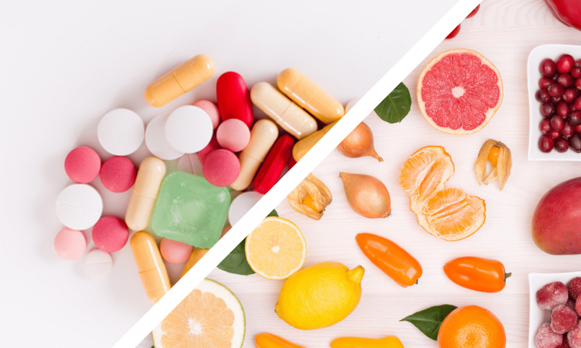
TYPES OF DRUG INTERACTIONS
2.Drug-food interactions

Slide 7
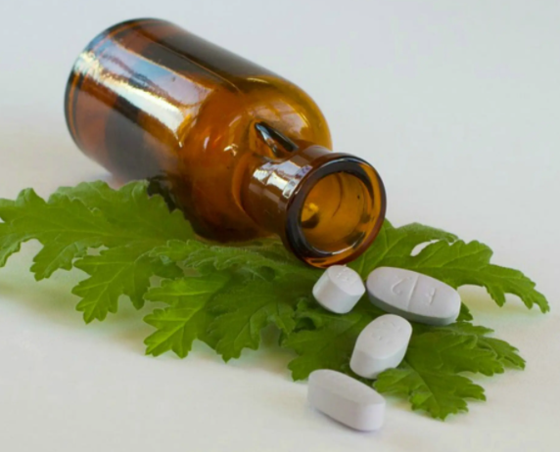
TYPES OF DRUG INTERACTIONS
3.Drug-herb/chemical interactions

Slide 8

TYPES OF DRUG INTERACTIONS
4.drug-disease interactions

Slide 9
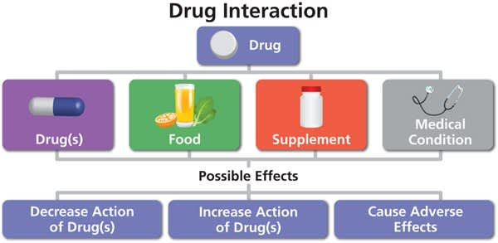
EFFECT OF DRUG INTERACTIONS

Slide 10
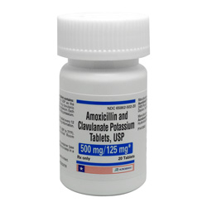
EFFECT OF DRUG INTERACTIONS
Undesirable – loss of therapeutic effect / toxicity
Beneficial – does not possess any undue risk to patient e.g., Amoxicillin & Clavulanic acid

Slide 11
FACTORS CONTRIBUTING TO DRUG INTERACTIONS
Multiple drug therapy
Multiple prescribers
Multiple diseases
Poor patient compliance
Advanced age
Drug related factors

Slide 12
MECHANISM OF DRUG INTERACTION
Pharmaceutical interactions
Pharmacokinetic interactions
Pharmacodynamic interactions

Slide 13
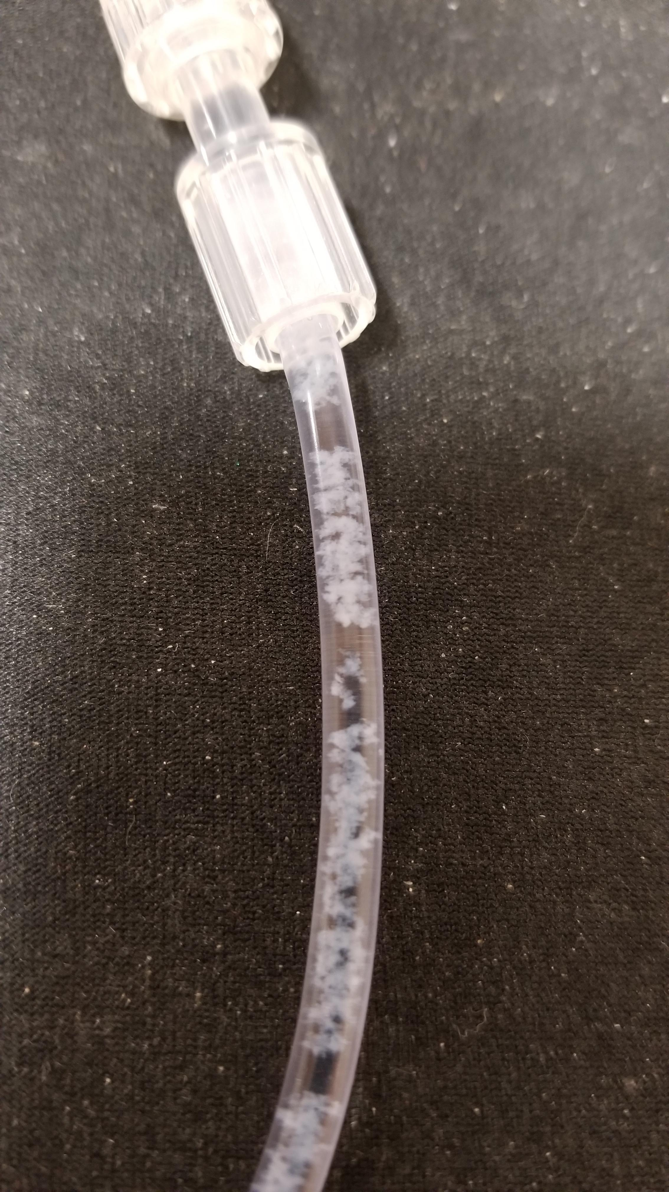
PHARMACEUTICAL INTERACTIONS
Occur before drugs are actually administered to the patient and generally represent incompatibilities of drugs administered by intravenous infusion
In practice, in vitro interactions occur when injectable drugs are mixed in the same syringe or infusion bottle
E.g., thiopentone & succinyl choline
E.g., paraldehyde – dissolve plastic/rubber tubings

Slide 14
PHARMACOKINETIC INTERACTIONS
Involves the effect of drug on another that includes
Absorption
Distribution
Metabolism
Excretion

Slide 15
ABSORPTION - INTERACTION
Altered PH
Formation of drug chelates/complexes
Drug induced mucosal damage
Altered GIT motility
Altered bacterial flora

Slide 16
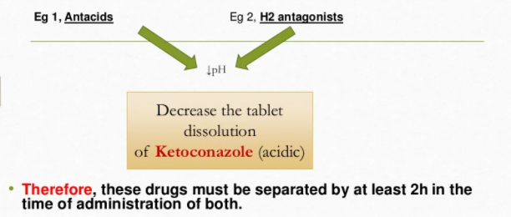
ALTERED PH

Slide 17
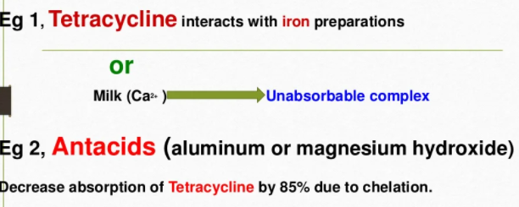
CHELATION

Slide 18
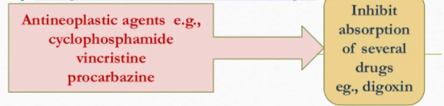
DRUG INDUCED MUCOSAL DAMAGE

Slide 19
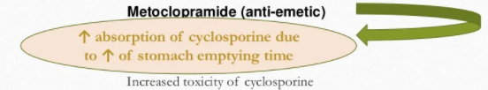
ALTERED GIT MOTILITY

Slide 20
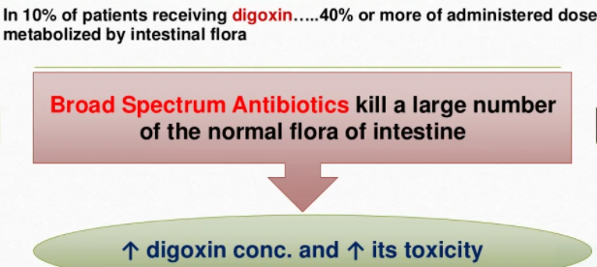
ALTERED INTESTINAL BACTERIAL FLORA

Slide 21
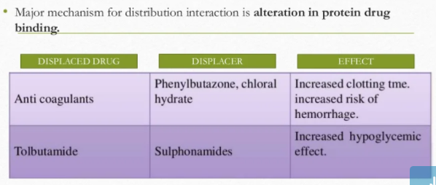
DISTRIBUTION INTERACTIONS

Slide 22
METABOLISM INTERACTIONS
Enzyme induction
Enzyme inhibition

Slide 23
ENZYME INDUCTION
A drug may induce the enzyme that is responsible for the metabolism of another drug or even itself
E.g., Rifampicin - plasma conc. Of OCPs – Contraceptive failure

Slide 24
ENZYME INHIBITION
Decrease in rate of metabolism of a drug by another.This will lead to increase conc. Of target drug, leading to its increased toxicity.
E.g., Erythromycin - plasma conc. Of terfenadine - cardiotoxicity

Slide 25
EXCRETION INTERACTIONS
Changes in active tubular secretion
Changes in renal blood flow

Slide 26
ACTIVE TUBULAR SECRETION
Penicillin/Cephalosporins/Nalidixic acid – Probenecid – Elevated plasma levels of acidic drugs

Slide 27
RENAL BLOOD FLOW
Lithium bicarbonate – NSAIDS – decreased renal clearance of lithium,risk of toxicity.

Slide 28
PHARMACODYNAMIC INTERACTIONS
Modification of the action of one drug at the target site by another drug,independent of a change in its concentration
May results in synergism,addictive effects,antagonism

Slide 29
SYNERGISM
When the therapeutic or toxic effects of two drugs are greater than the sum of effects of individual drugs
E.g., sulfamethoxazole + trimethoprim – anti-microbial agent

Slide 30
ADDICTIVE EFFECTS
Net effect of two drugs used together is equal to the sum of the individual drug effects
E.g., thiazide + beta adrenergic blockers - hypertension

Slide 31
ANTAGONISM
The effect of one drug can be reduced or abolished by the presence of another drug
E.g., blockade of anti-parkinsonian action of levodopa by neuroleptics and metoclopramide having anti-dopaminergic action

Slide 32
DRUG-FOOD INTERACTIONS
GRAPE FRUIT JUICE – inhibits CYP3A4
VITAMIN K rich foods - risk of clotting
GARLIC- anti-clotting properties
MILK – Mg & Ca – chelate tetracycline
ORANGE- constipation when combined with aluminum (ANTACIDS)
OATMEAL – interfere with absorption of digoxin

Slide 33
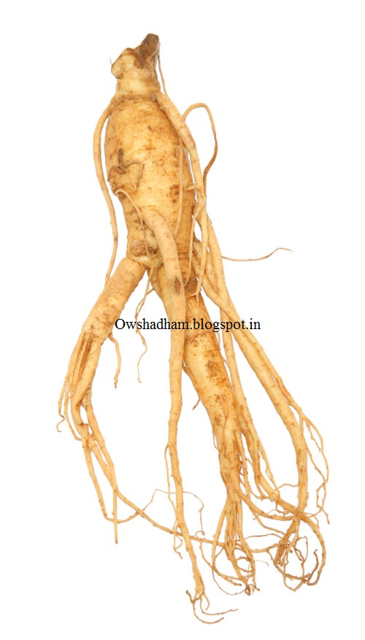
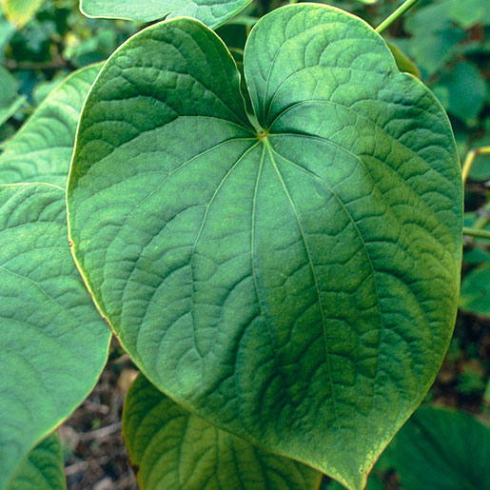
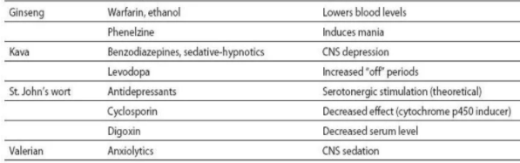


DRUG-HERB INTERACTIONS

Slide 34
DRUG-DISEASE INTERACTIONS
Drug- condition interaction occurs when a drug worsens or exacerbates an existing medical condition
E.g., Nasal decongestants + Hypertension - Blood pressure

Slide 35
DRUG-SMOKING
activity of drug metabolizing enzymes in liver
effect of theophylline, diazepam, olanzapine is decreased

Slide 36
DRUG-ALCOHOLIC BEVERAGES
depressive effects of benzodiapines, anti-histamines, narcotics
Disulfiram like reaction with metronidazole
metabolism of warfarin & phenytoin

Slide 37
HOW TO PREVENT/AVOID DRUG INTERACTIONS
Have to monitor for potential drug interactions
Advice patients proper use of medicines
Educate the patient for food and beverages while on medication
Avoid multi-drug therapy when not needed
Avoid OTC drugs
Caution in elderly people is needed

Slide 38
21.02.2022 PH 1.8 IDENTIFY & DESCRIBE THE MANAGEMENT OF DRUG INTERACTIONS IN THE FOLLOWING CASE SCENARIOS
A 35 Year Old Male, Type I Diabetes Mellitus On Insulin Was Treated With Propranolol As A Prophylactic Therapy For Migraine.

Slide 39
Explain The Potential Drug Interaction In This Patient:
Propranolol Blunts the Recognition Of Hypoglycemia & Delays Recovery From Insulin Induced Hypoglycemia. Propranolol A Non—Selective β—Blocker Blocks β₂ mediated Glycogenolysis & Neoglucogenesis In Liver & Aggravates Insulin Induced Hypoglycemia.
It Also Suppresses The Warning Signs Of Hypoglycemia Like Tremors, Tachycardia, Palpitation, Sweating Mediated Through Sympathetic Stimulation By blocking β—Adrenergic Receptors.

Slide 40
B)How Will You Manage ?
Patient Can Be Prescribed Selective β₁ --blockers Like Metoprolol/ Atenolol Or Calcium Channel Blocker Like Flunarizine As Prophylactic Drug Therapy. These Drugs Are Less Likely To Blunt Symptoms & Delay Recovery From Hypoglycemia.

Slide 41
2.A 65 Year Old Male Was Complaining Of Pain In Both Knee Joints For Which Diclofenac Twice Daily Was Prescribed By His Physician . He Was A Known Hypertensive Well Controlled With Enalapril 10mg/day. When He Came For Review After 3 Weeks, his BP Was 160/100 mm Hg.

Slide 42
Comment On The Possible Drug Interaction. Explain The Reason For Raised BP.
Dicofenac NSAID Reduces The Antihypertensive Effect Of Enalapril By Blocking The production Of Vasodilator & Natriuretic PG Production In Kidney. This Results In Increased BP.
Hyperkalemia Produced By Combination Of NSAID & ACE—I Can Produce Marked Bradycardia Leading To Syncope especially In Elderly & In Patients With Hypertension, DM, & IHD.

Slide 43
B) What Is The Interaction Of NSAID With Other Antihypertensives ?
NSAIDS Attenuate The Antihypertensive Effect Of ACE –I, ARB, Diuretics & β –blockers.
They Are Less Likely To Attenuate The Antihypertensive Effect Of Calcium Channel Blockers & Centrally Acting Antihypertensives Whose Actions Are Unrelated To Renal/Extra Renal Production Of PG.

Slide 44
3. A 30 Year Old Female Patient Was Prescribed Erythromycin 500mg Qid For Upper Respiratory Infection. She Was A Known Case Of Bronchial Asthma Maintained On Salbutamol Inhalation & Oral Theophylline 300mg Three Times A day. After 5 Days She Presented With Restlessness, Irritability, Insomnia & Palpitation.

Slide 45
a)How Would You Explain These Signs & Symptoms:
The Signs & Symptoms Are Due To Increased Plasma Level Of Theophylline Causing CNS Stimulation. Erythromycin Inhibits hepatic Metabolism Of Theophylline By Inhibiting Microsomal CYP 3A4 .
b)What Is The Line Of Management ?
The Dose Of Theophylline Should Be Reduced Or Erythromycin Should Be Stopped & Replaced By Azithromycin Or β—Lactam Antibiotics Like Ampicillin/Amoxicillin.

Slide 46
4) A 45 Year Old Male Patient Was On Isosorbide Dinitrate 10mg bd For Angina. A Quack Prescribed T.Sildenafil For Erectile Dysfuction. The Patient Fainted At Home & Was Rushed To The Hospital. On Examination The Patient Was Dyspnoeic With Pulse Rate 115/mt & BP 80/60mmHg .

Slide 47
Explain The Potential Drug Interaction In This Patient:
Sildenafil Potentiate The Vasodilator Action Of Nitrates Producing Dangerously Low BP Resulting In Severe Hypotension, MI & Death. Sildenafil Retard The Degradation Of cGMP By Inhibiting PDE—5 . ↑ In cGMP Results In Vascular Smooth Muscle Relaxation & Increased Blood Flow To Corpora Cavernosa Causing Penile Erection .

Slide 48
b) What Advice Will You Give To The Patient ?
Administration Of Sildenafil Is Contraindicated In Patients With IHD & In Those Receiving Organic Nitrates.The Patient Is Advised Not To Take Sildenafil.

Slide 49
5. A 30 Year Old Female Was Diagnosed As Having Pulmonary TB And Was Put On First Line Anti—tubercular Drugs ( RMC + INH + EMB + PZ ). She Has Been On Oral Contraceptive Pill Since 2 Years.

Slide 50
a) Comment On Possible Drug Interaction In This Patient:
OCP Are Fixed Combination Of Estrogen & Progesterone. Rifampicin Is A Microsomal Enzyme Inducer Which Enhances The metabolism Of OCP resulting In Decreased Effect Of OCP. This May Result In Failure Of Contraception/ Breakthrough Bleeding And Spotting.

Slide 51
b) How Would You Manage ?
OCP With Higher Dose Of Estrogen + Progesterone Should Be Used Or Couples Should Use Other Mode Of Contraception.

Slide 52
6. A 40 Year Old Female Had Been On Lithium Carbonate 300mg Daily Since 3 Years For Maniac Depressive Illness. Recently She Was Diagnosed As Having Stage I Hypertension For Which She Was Prescribed Hydrochlorothiazide 25mg Daily. 4 Weeks Later She Came To The Emergency Department With severe Tremors, Ataxia, Muscle Rigidity, Nystagmus And Hyperreflexia.

Slide 53
Explain The Reason For The Above Signs And Symptoms:
The Above Signs And Symptoms Are Due To Increased Plasma Level Of Lithium.
Hydrochlorothiazide Is A Thiazide diuretic Which Cause Sodium Loss By Inhibiting Na⁺ Cl⁻ Co-Transporter In DCT. Lithium Being A Monovalent Cation is Handled By The Kidney In The Same way as Na⁺ . Hence Na⁺ Loss By Diuretics Promote Reabsorption Of Lithium In PCT.

Slide 54
b) How Will You Manage ?
Lithium And diuretics ( Furosemide,Thiazides) Are Not Given Together. The Woman Should Be Prescribed Other Anti-hypertensives Like Ca²⁺ Channel Blockers. ACE-I And ARBs Also Cause Lithium Retention.

Slide 55
7. A 30 Year Old Female, Known Epileptic Was Well Controlled With Sodium Valproate. She Was Prescribed Ciprofloxacin With Paracetamol For Enteric Fever. After 4 Days She Developed Seizures.

Slide 56
Comment On The Possible Drug Interaction:
Paracetamol ( NSAID ) Augment Displacement Of GABA from Its Receptors By Ciprofloxacin (Quinolones) . This Reduces Seizure Threshold And Precipitate Seizures In Epileptic Patients.

Slide 57
b) Name 2 Drugs That Precipitate Seizures In Epileptics:
Methyl Xanthines --- Theophylline, Aminophylline
CNS Stimulants --- Cocaine , Amphetamine
Opioids --- Tramadol
Anti tubercular Drug --- INH
Tricyclic Antidepressants ---Imipramine, Clomipramine, Amitriptyline
Atypical Anti psychotics --- Clozapine, Olanzapine

Slide 58
8. A 35 Year Old Obese Female Was On Warfarin Therapy For Deep Vein Thrombosis . She Developed Pelvic Infection For Which She Was Given Amoxicillin + Clavulanic acid . On The 4th Day She Started Bleeding PV And Passing Dark Urine. INR Was 5.6.

Slide 59
a) What Is The Reason For Raised INR & Bleeding Symptoms ?
Warfarin Is An Oral Anticoagulant Which Acts By Inhibiting Hepatic Synthesis Of Vit K Dependent Coagulation Factors (II,VII,IX,X). Amoxicillin + Clavulanic Acid Is Extended Spectrum Penicillin. It Causes Inhibition Of Gut Flora Resulting In Reduction In Synthesis Of Vit K. Therefore ↓ In Vit K Level Enhances Warfarin Toxicity And Increases INR.
b) How Will You Manage ?
Reduction In Warfarin Dose And INR Monitoring

Slide 60
9 . A 30 Year Old Female Was Diagnosed To Have Urinary Tract Infection . Urine Culture Showed Growth of E.Coli Organisms Sensitive To Ampicillin. The Physician Prescribed Ampicillin + Probenecid.

Slide 61
a) Why Did The Physician Prescribe Probenecid ?
Ampicillin, B –lactam Antibiotic, Is Excreted Unchanged By Tubular Secretion Through Organic Anion Transporter In The PCT. Probenecid Competitively Bocks OAT And Inhibits The Excretion Of Ampicillin Resulting In Higher Plasma Concentration And Prolonged Half life. The Advantage Is Reduced Dose And Reduced Frequency Of Administration.

Slide 62
b) Give 2 Examples Wherein Probenecid Is used For Similar Purpose:
Amoxicillin + Probenecid
Ceftriaxone + Probenecid
Cefuroxime + Probenecid

Slide 63
10. A 40 Year Old Alcoholic Was Treated With Metronidazole 400mg Thrice Daily For Amobic Dysentry. He Presented Next Day With Severe Flushing, Throbbing Headache, Nausea, And vomiting.

Slide 64
a) Explain The Possible Reasons For These Symptoms.
Ehanol -------------------------------> Acetaldehyde----------------------------------→ Acetic Acid
Alcohol Dehydrogenase Aldehyde Dehydrogenase
Metronidazole Inhibits Aldehyde Dehydrogenase And Prevents The Conversion Of Acetaldehyde To Acetic Acid .The Concentration Of Acetaldehyde Raises In the Body Giving Raise To The Above Signs And Symptoms. This Reaction Reinforces Aversion To Alcohol. Hence This Reaction Is Called Antabuse Reaction.

Slide 65
b) Mention 2 Drugs Which Produce Similar Reaction With Alcohol:
Chlorpropamide, Tolbutamide
Nitrofurantoin
Griseofulvin

Slide 66
END…….
THANK YOU

